Slide 1
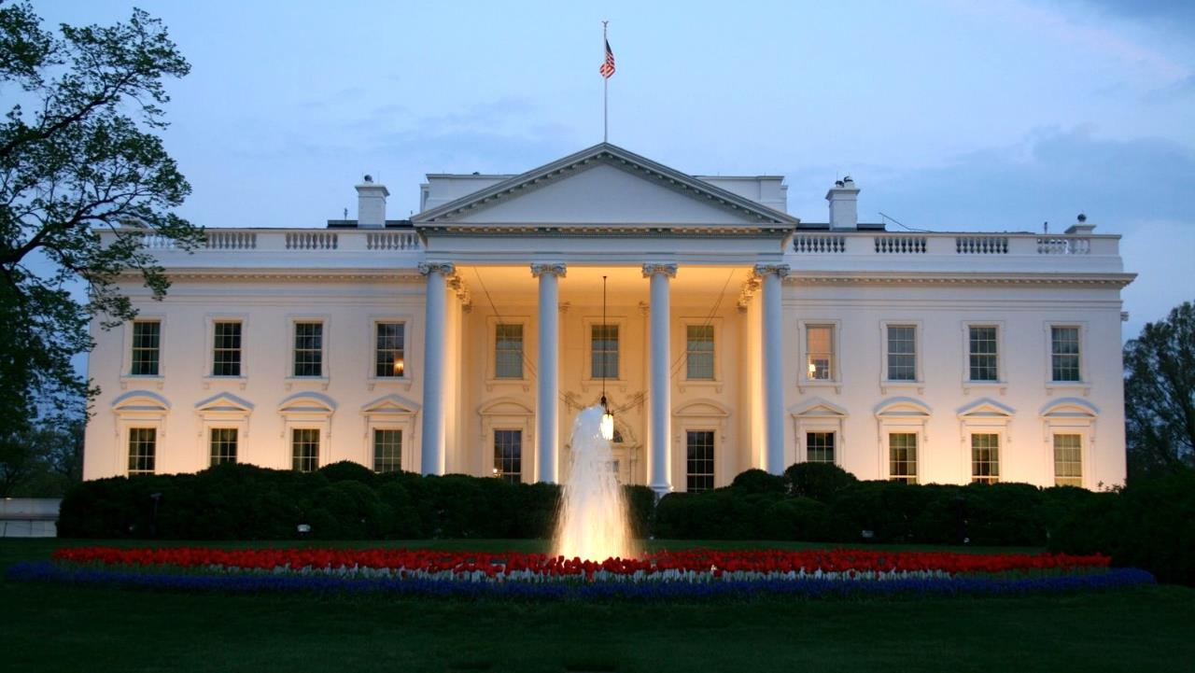
Whose Hats? Predicting the launch of 2020 Presidential campaigns
Thomas Bahng
Matt Kruse
Lauren Lawless
Alex Manso
IST 736: Text Mining
Final Presentation
Spring 2020

Slide 2
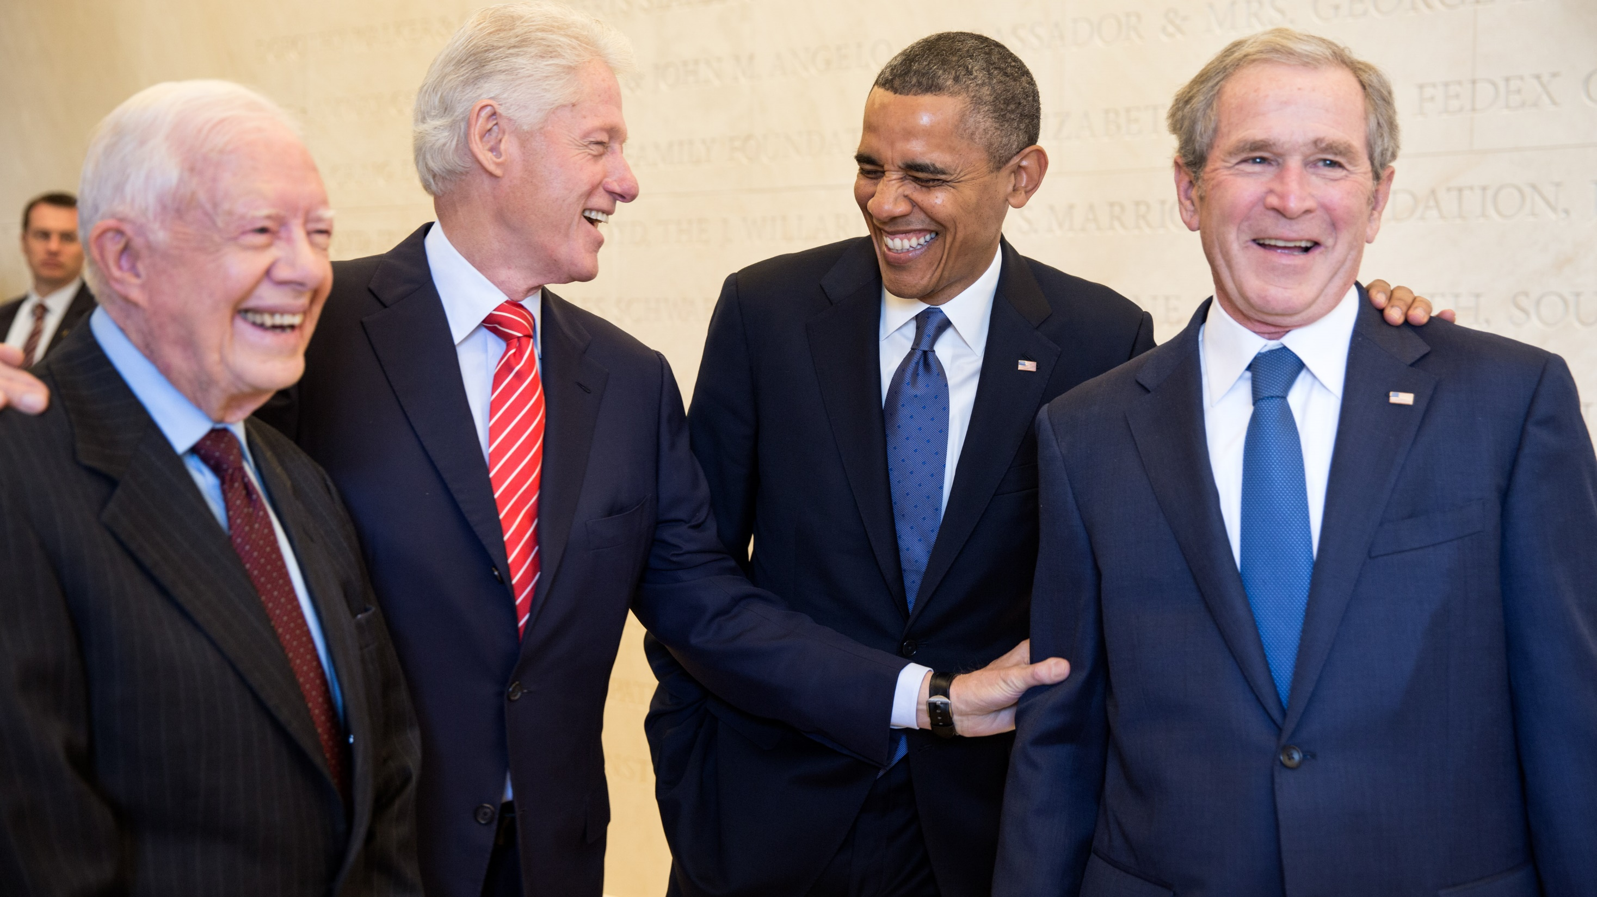
History Of POTUS
Parties
Terms
Professions
Race
White: 44
Black: 1
Gender
Men: 45
Age

Slide 3
2008 | 2012 | 2016 | 2020
Open field | Democratic Incumbent | Open field | Republican Incumbent
Democratic Party Candidates: 10 | Democratic Challengers: 4 | Democratic Party Candidates: 6 | Democratic Party Candidates: 29
Republican Party Candidates: 12 | Republican Party Candidates: 13 | Republican Party Candidates: 17 | Republican Challengers: 4
Recent Presidential Races

Slide 4
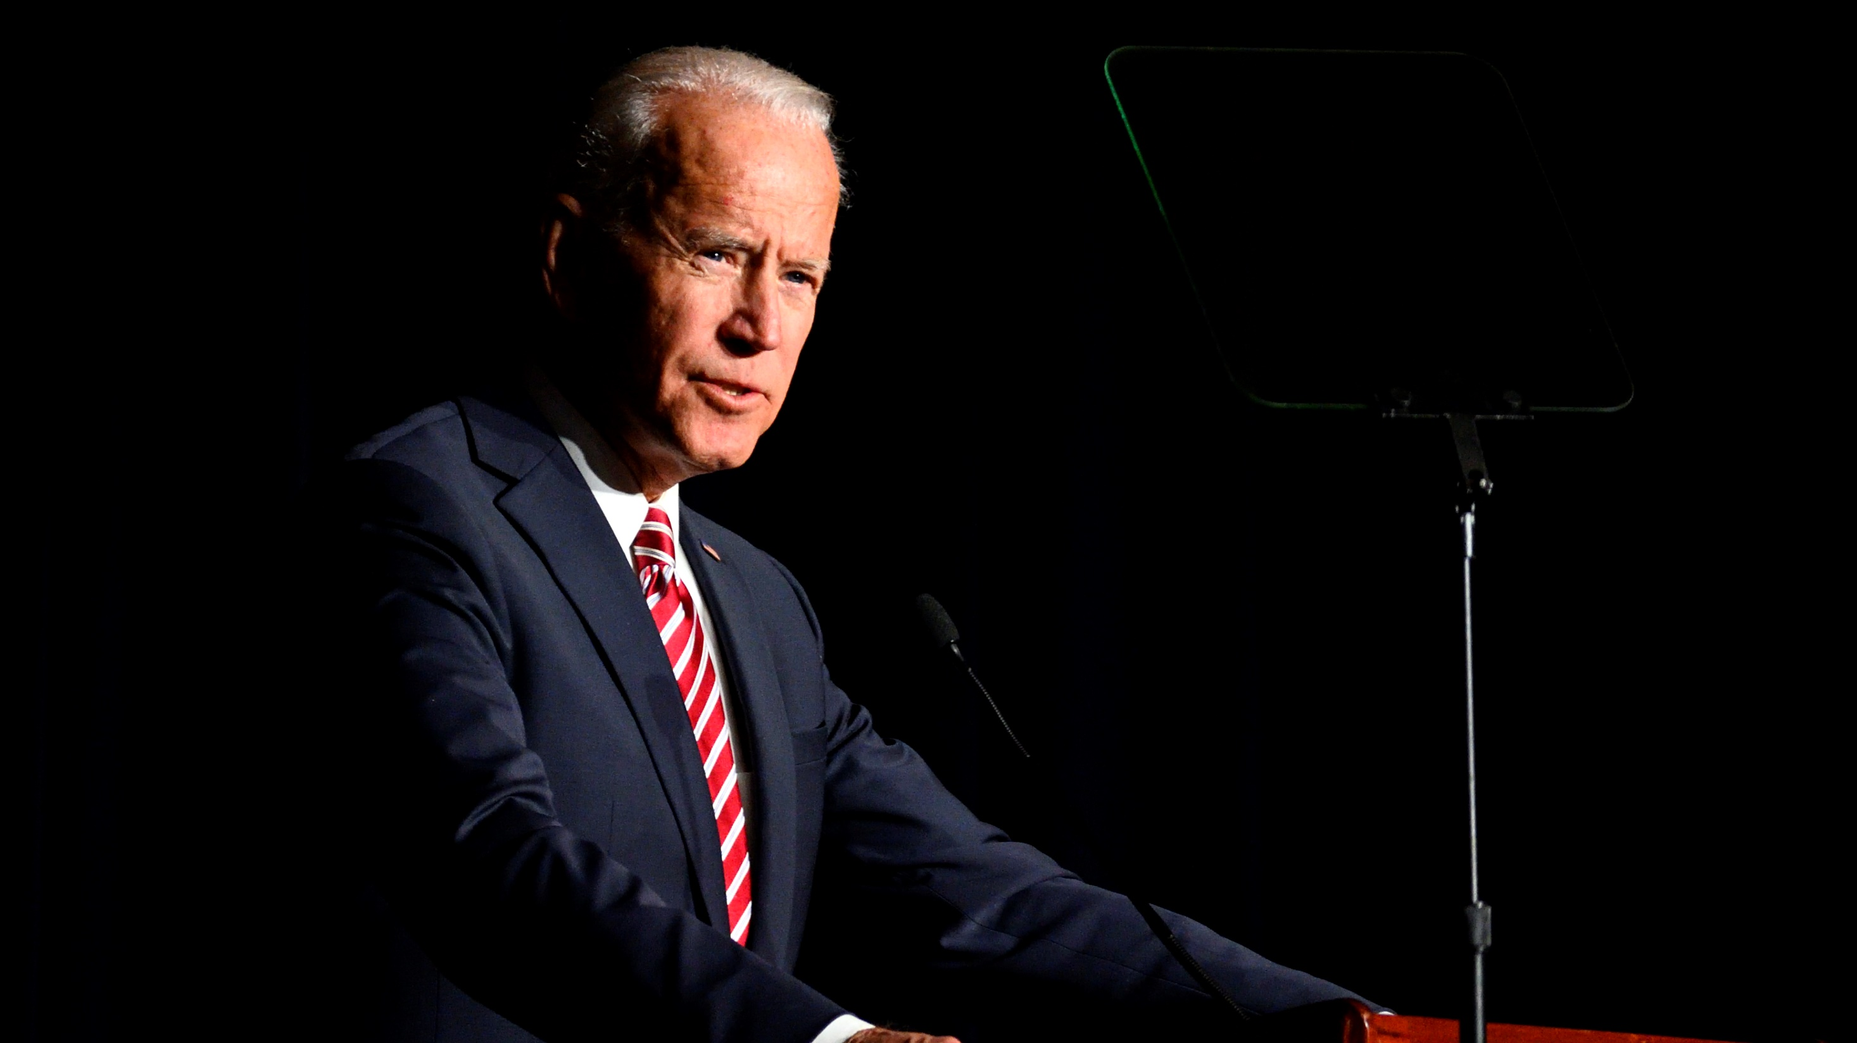
About the Data

Slide 5
A Collection of Individuals & Tweets
110 Twitter handles
Candidates and non-candidates
55% Democrats; 45% Republicans
300,000+ Tweets
Created between 2008 and 2020
~3000 tweets per individual
Average length: 93 characters; 19 words
Total vocabulary: ~98,000 words

Slide 6
Lexicon & Sentiment Tweets are similar between groups in common terms, grammar, and sentiment
Candidates
Non-Candidates

Slide 7
Clustering
Two distinct clusters
Candidates vs. Non-candidates
Non-candidate exceptions (21):
SenSchumer
SenMarky
HillaryClinton*
Keithellison
PramilaJayapal
IlhanMN
MartinOMalley*
Lessig*
GovMikeHuckabee*
RandPaul*
RepThomasMassie
ScottWalker*
Marcorubio*
JimWebbUSA*
Tedcruz*
TedYoho
GovHowardDean
RepGosar
MarkMeadows
LindseyGrahamSC*
RepAlGreen
* Ran in the 2016 primary
Exceptions for candidates (3):
MauriceGravel
WayneMessam
MarkSanford
Most distinctive terms:
One
People
Trump
Every
Right
Today

Slide 8
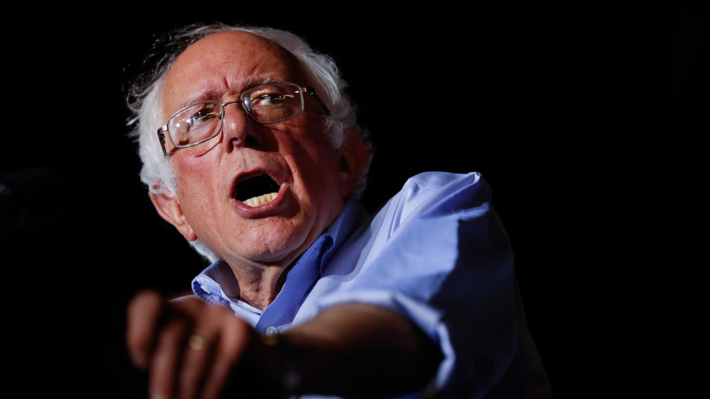
Models & Results

Slide 9
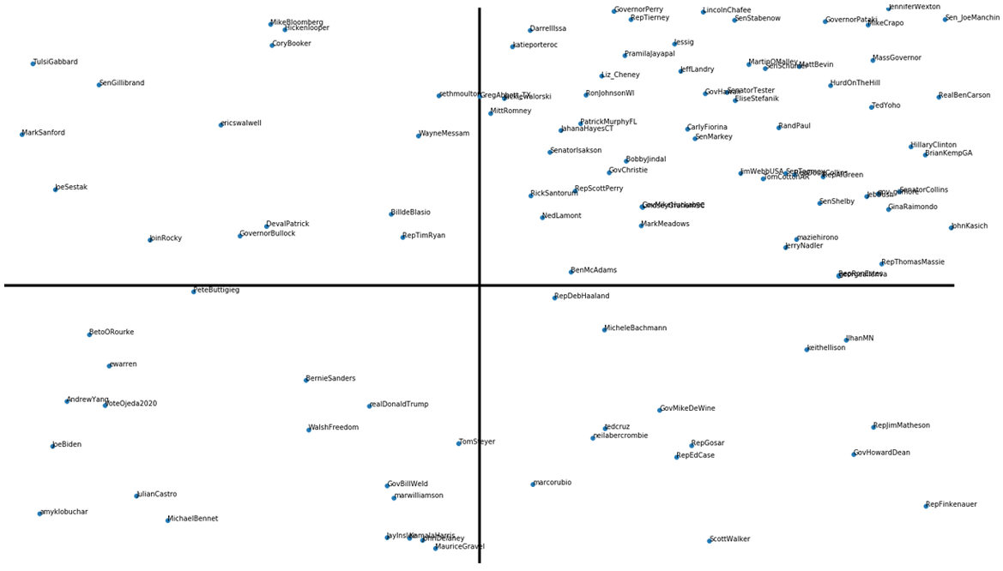
Tweeter Groups
Candidates Non-candidates
No Tweets before 2018 Tweets before 2018

Slide 10
Data Strategies
API Balancing + Bias Mitigation
Tweets through Last Announcement

Slide 11
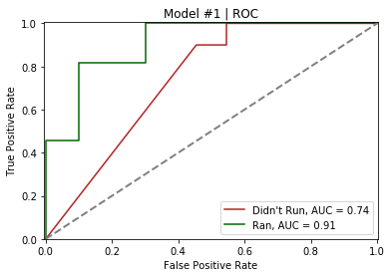
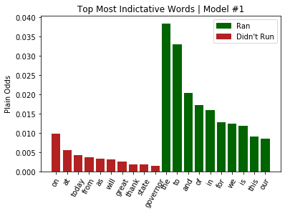
Model 1
Data Strategy 1
Used median tweets for users missing 2018 data
CountVectorizor defaults
23,000 features
68 total samples (34 candidates; 34 non-candidates)
Multinomial Naïve Bayes classifier
5-fold cross-validation
Train Accuracy: 81%
Test Accuracy: 75%

Slide 12
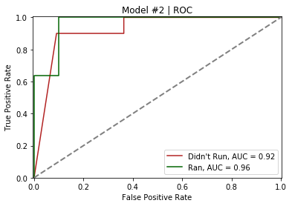
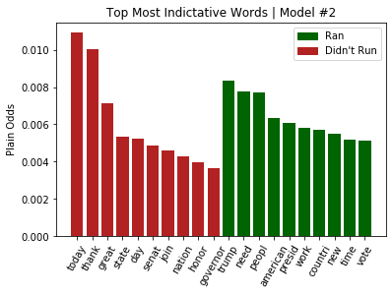
Model 2
Data Strategy 1
Used median tweets for users missing 2018 data
CountVectorizor with stemmer, remove stopwords, min_df 10%
2,200 features
68 total samples (34 candidates; 34 non-candidates)
Multinomial Naïve Bayes classifier
5-fold cross-validation
Train Accuracy: 88%
Test Accuracy: 80%

Slide 13
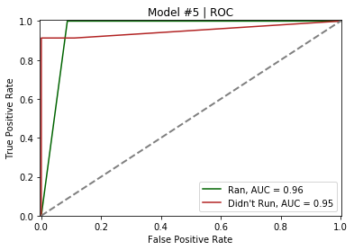
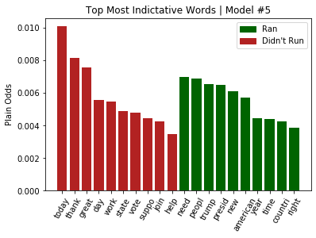
Model 5
Data Strategy 2
Used all tweets prior to 11/25/2019
CountVectorizor with stemmer, remove stopwords, min_df 10%
7,700 features
106 total samples (30 candidates; 76 non-candidates)
Multinomial Naïve Bayes classifier
5-fold cross-validation
Train F1 Measure : 95%
Test F1 Measure: 92%
Precision_{candidate} = 0.82 Precision_{non-candidate} = 1.00 Recall_{candidate} = 1.00 Recall_{non-candidate} = 0.91 F1_{candidate} = 0.92 F1_{non-candidate} = 0.95

Slide 14
Model | Data Strategy | Vectorizer | Vectorizer Parameters | Classifier | Classifier Parameters | Train Score | Test Score
1 | API Balancing | CountVec | Default | MNB | Laplace = 1 | 81% | 75%
2 | API Balancing | CountVec | Stemmer, Stopwords, min_df = 10% | MNB | Laplace = 1 | 88% | 80%
5 | Through Nov. 2019 | CountVec | Stemmer, Stopwords, min_df = 10% | MNB | Laplace = 1 | 95% | 92%
Model Summary

Slide 15
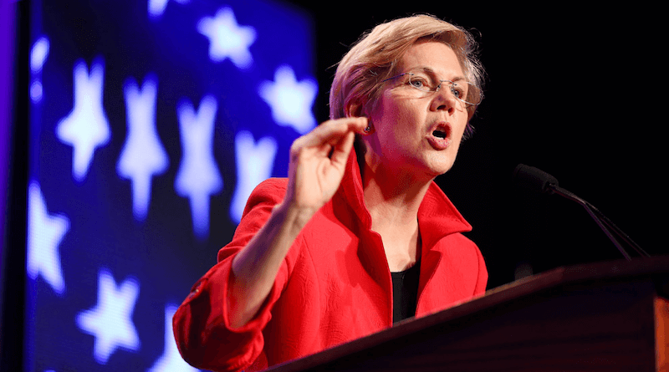
Conclusions

Slide 16
Conclusions
Presidential candidacy is Tweet-predictable
People aren’t born Tweeting like a candidate
Candidates speak more about the current President
Potential improvements from utilizing non-Tweet data

Slide 17
Thank you

